Slide 1

VSMUG – 2020-06
User Group Lead
Justin Chalfant
justin@patchmypc.com
Founder - Patch My PC
Twitter: @SetupConfigMgr
Virtual System Management User Group
Website: https://vsmug.com/
Content: https://vsmug.com/github
Twitter: @V_SMUG
YouTube: https://vsmug.com/youtube
Notes:
Basic intro for myself and the user group

Slide 2
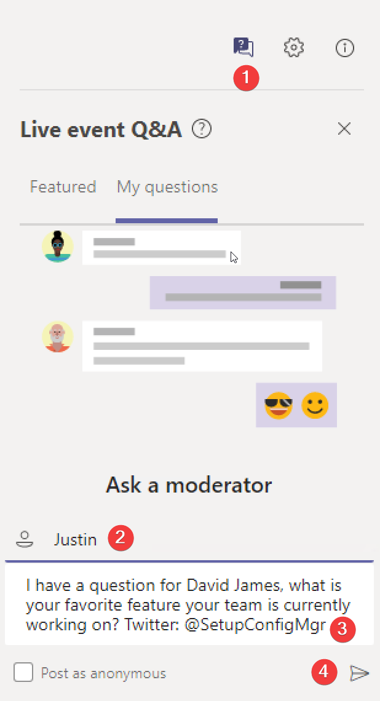
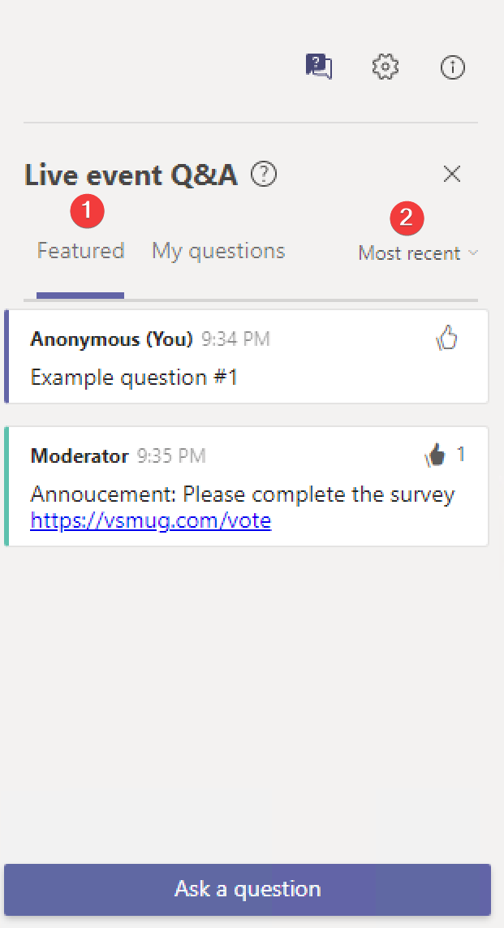
Live event - Asking questions❓
Let’s keep it interactive
Ask questions
View questions
Upvote questions
Filter question by likes / most recent
Notes:
How to use a team's live event to ask questions

Slide 3
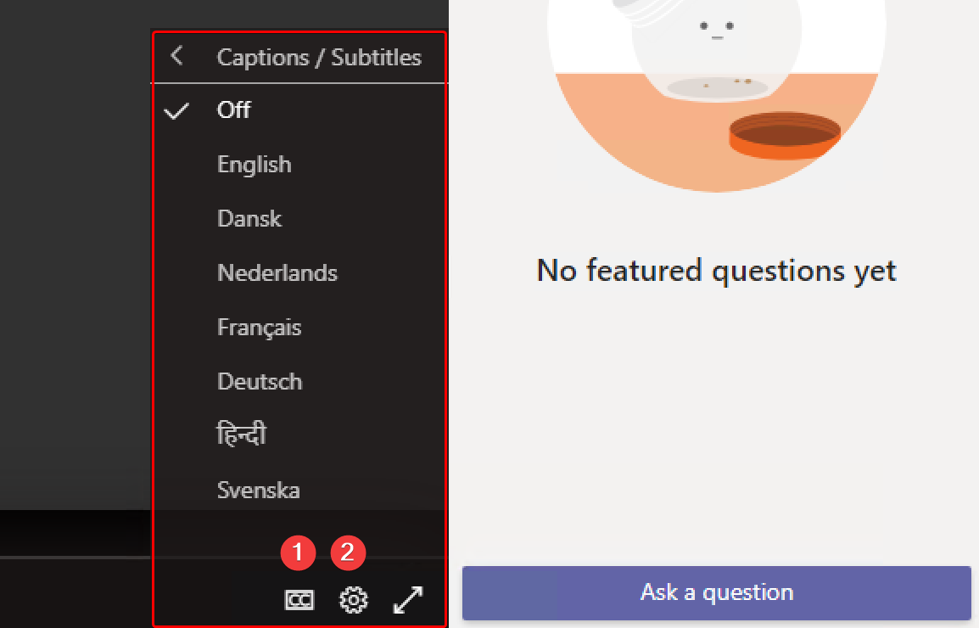
live captions
Optional: enable captions
Team's live events support live captions for up to 7 languages.
Notes:
How to use live captions – 7 languages

Slide 4
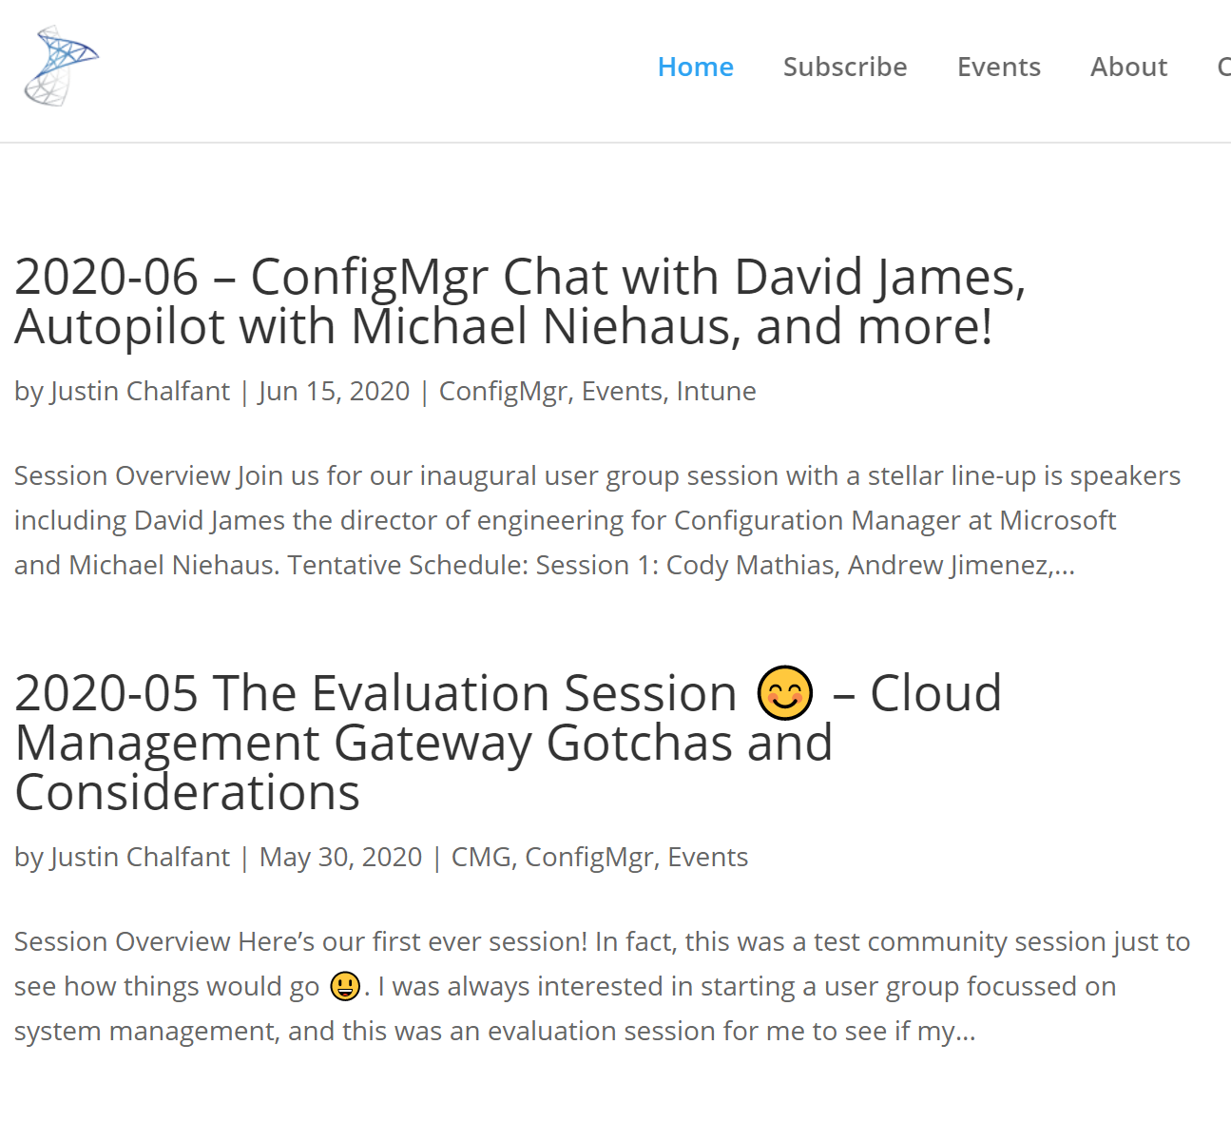
What is vsmug?
VSMUG Website & Social
https://vsmug.com/
https://vsmug.com/youtube
Twitter: @V_SMUG
Vsmug goal
The goal of the group is to share experiences and help all members become more involved and learn more about our field.
To get involved email me justin@patchmypc.com
Notes:
The goal of the group

Slide 5
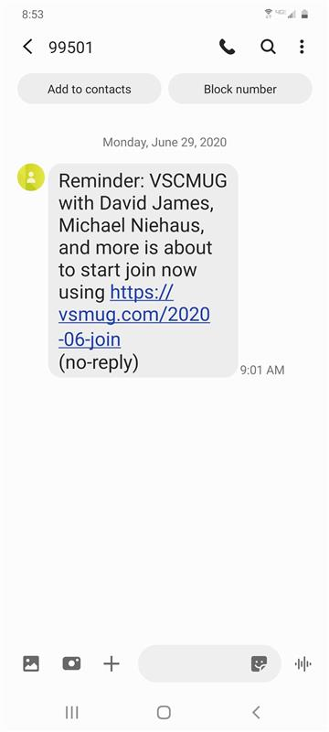

First event Growing pains 🤦‍♂️
Sorry if you got a text
Our text message went out a day early. ☺
Notes:
Our bad, we sent a text early.

Slide 6
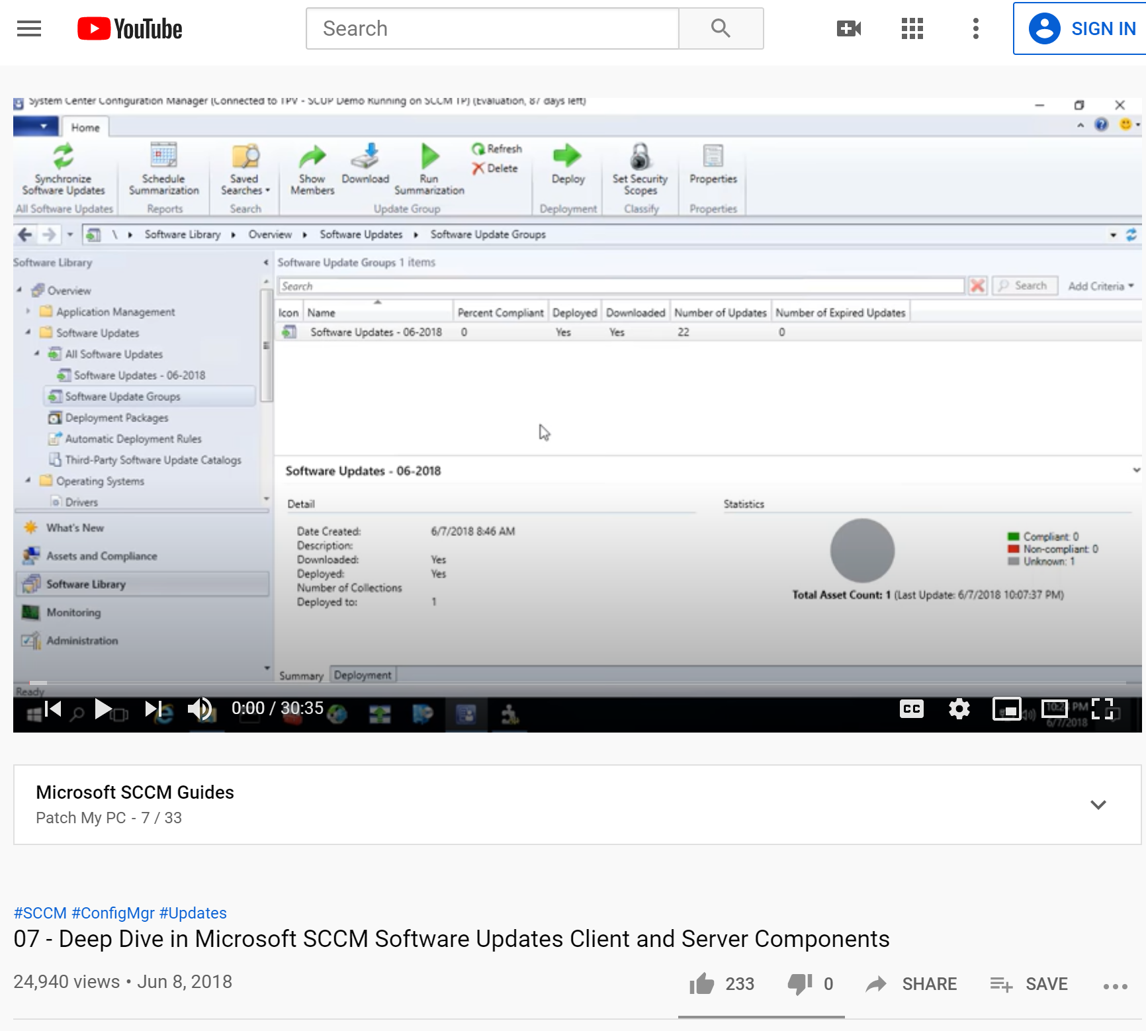
About me – video guides
Configuration Manager Gudie Playlist:
https://setupconfigmgr.com/youtube
Notes:
About me vlogging

Slide 7
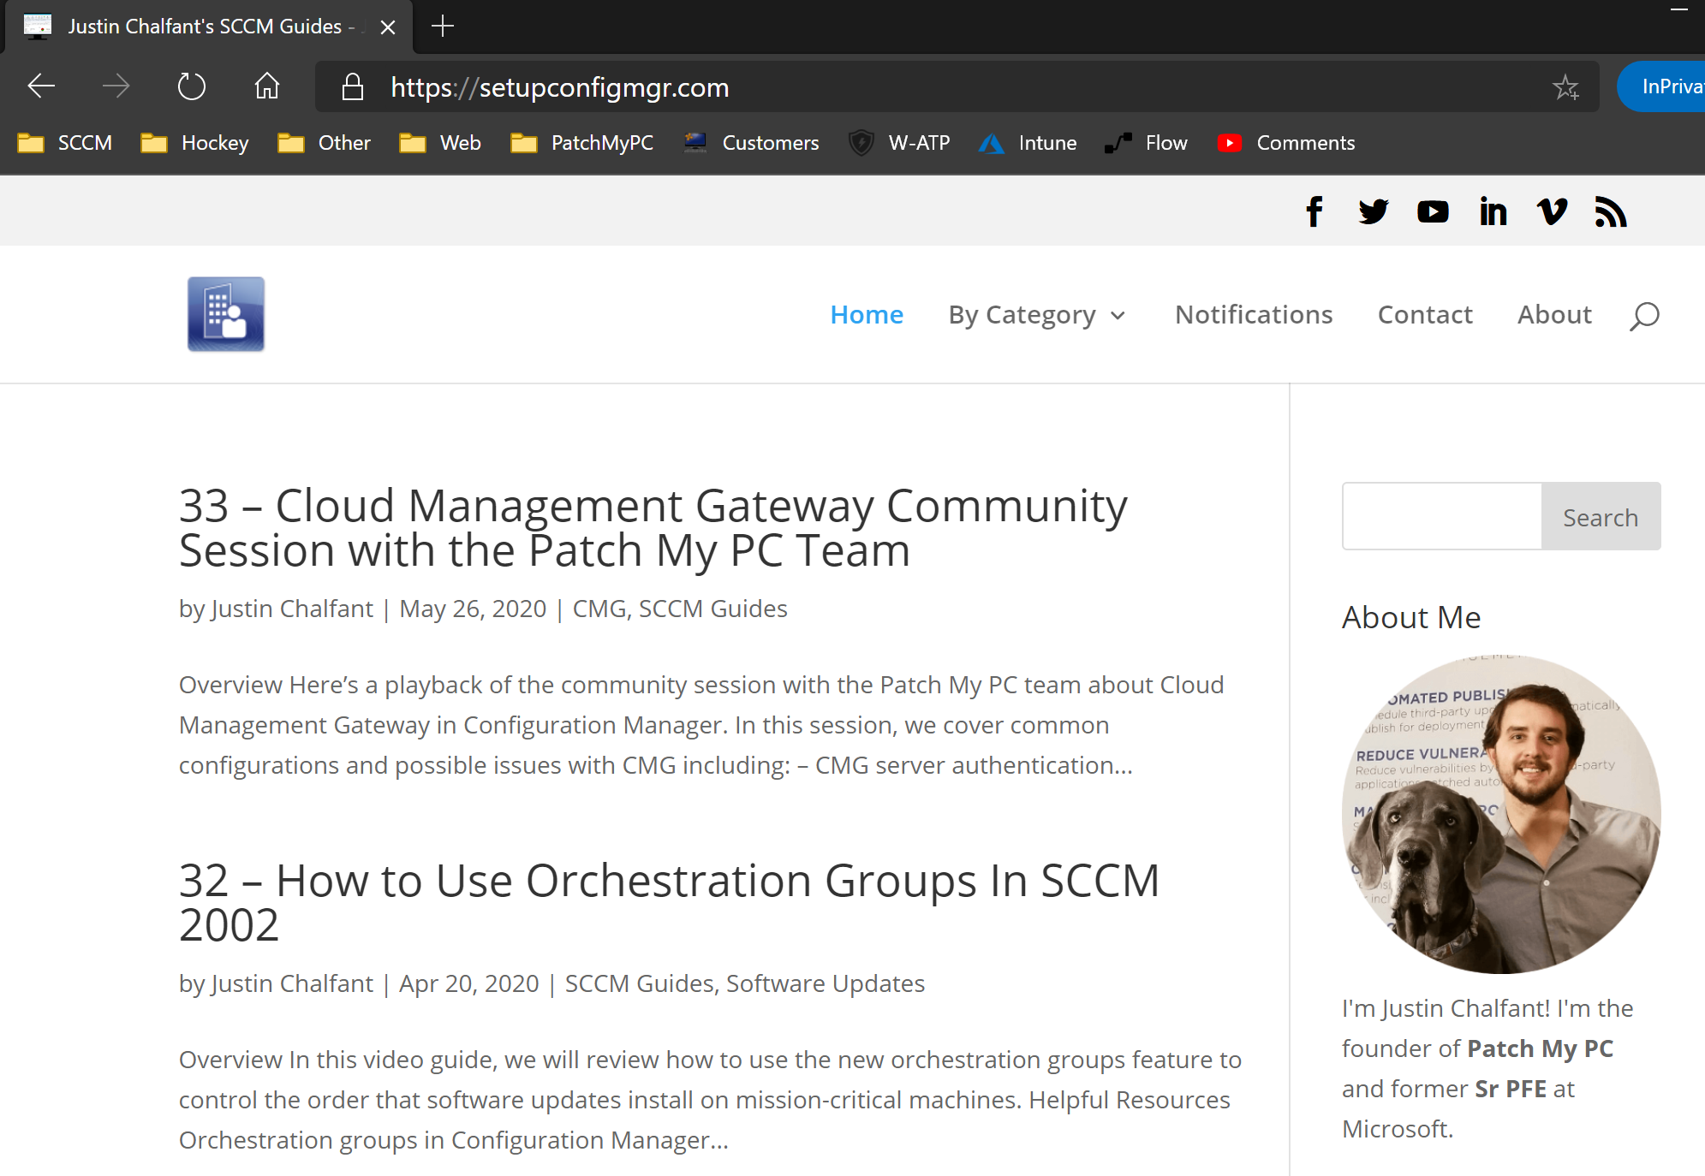
About me - Blogs
Current Blog
https://setupconfigmgr.com/
Previous Microsoft Blog:
https://docs.microsoft.com/en-us/archive/blogs/jchalfant/
Notes:
About me – blogging

Slide 8

Go vote - Meeting cadence? 📅
Please go vote now! 👇
https://vsmug.com/vote
Notes:
Please vote on the cadence

Slide 9

Submit a session
Submit a session! 👇
https://vsmug.com/session-submission
Notes:
Get involved, submit a session

Slide 10
Configuration items and baselines
Cody Mathis and Andrew Jimenez

Slide 11
Section Header
This is the next section

Slide 12
Title
Line1
Bullet Level 1
Bullet Level 2
Bullet Level 3

Slide 13
Title
Code

Slide 14
Text Only with Border
Level 1
Level 2
Level 3

Slide 15
Text Only (Red)
Level 1
Level 2
Level 3

Slide 16
Title
Text 1
Level 1
Level 2
Level 3
Text 2
Level 1
Level 2
Level 3

Slide 17
Title
Section 1
Section 2
Text
Level 1
Level 2
Level 3
Text
Level 1
Level 2
Level 3

Slide 18
Demo Title

Slide 19





























Slide 20






























Slide 21




























Slide 22




























Slide 23




























Slide 24




























Slide 25




























Slide 26























Slide 27
















